Slide 1

San Antonio 311 Analysis
Yixiao Li, Manuel Perez,
Drew Parsons, Ben Polan, and Dylan Rowe

Slide 2
Background
311 connects residents to the city’s non-emergency services and provides general information about San Antonio.
An average of 5349 contacts to 311 per week.
Reasons for contact can include requests for information, request solid waste pickup, report streetlight outage, report graffiti, and many others.
Citizens can contact the city via phone call, mobile app, or on the web.
There is also an internal request process for city employees.

Slide 3
Motivation
Our analysis aims to be an evaluation of San Antonio’s continued efforts to be a “Smart City”, specifically, to answer critical questions about its 311 service in hopes to improve foresight, responsiveness, and efficiency.

Slide 4
Main Questions
Which types of request take the longest to fulfill and what are the main causes for these delays?
What are the most important factors when predicting if a case will be completed late or on time?
Does the source of the request have an impact on response time?
Does Council District have an effect on response time?
What patterns can we find in the data regarding time, category, and source.

Slide 5
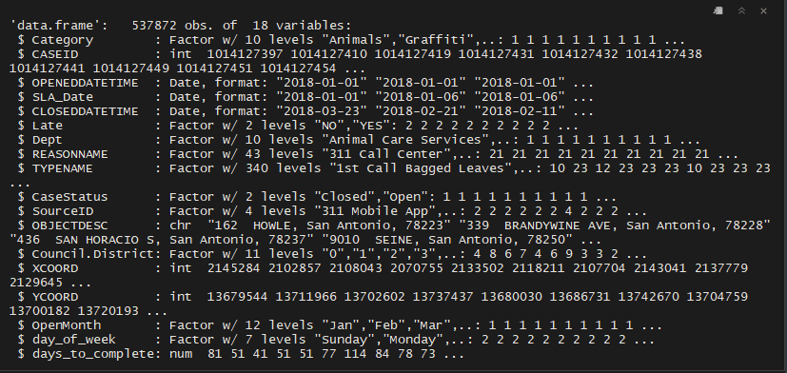

The Data

Slide 6
Analysis Techniques
Exploratory
Tables and graphs by differing variables to get an understanding of the data and identify potential insights.
Inferential
Linear and Logistic Regressions
Decision Tree
All models were an attempt to gain an understanding of what made the service requests late.

Slide 7

Data Exploration

Slide 8
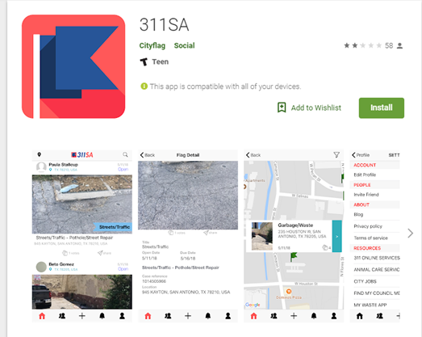
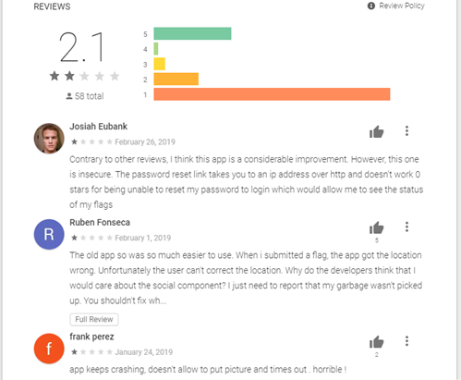
New App: 311 SA by CityFlag

Slide 9
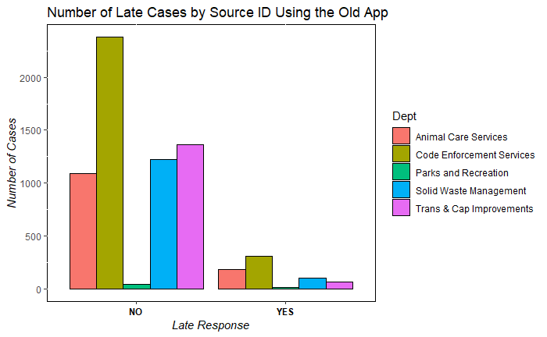
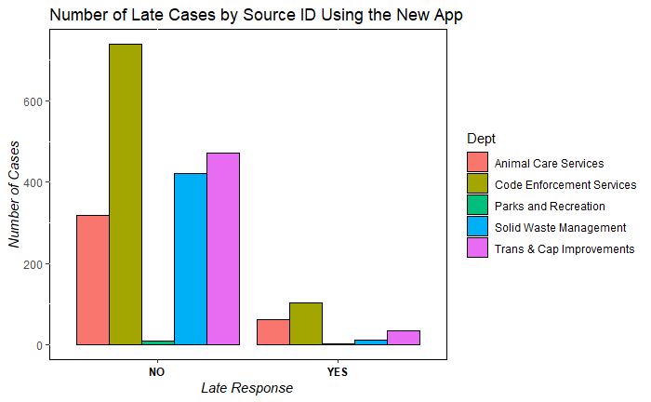
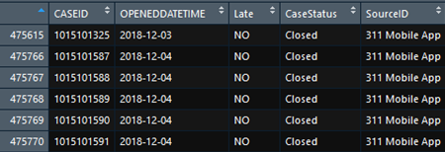
New App vs Old App
The old app was used far more than the new one, this can
be seen by the scale being exponentially larger than the new
app scale. The new app was in action for several months and it has not been used since
has not been used since December 4, 2018.

Slide 10
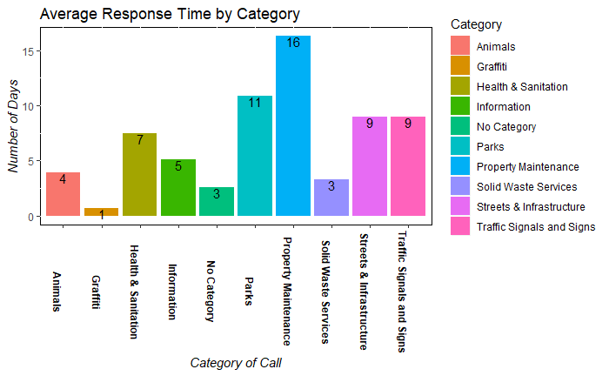
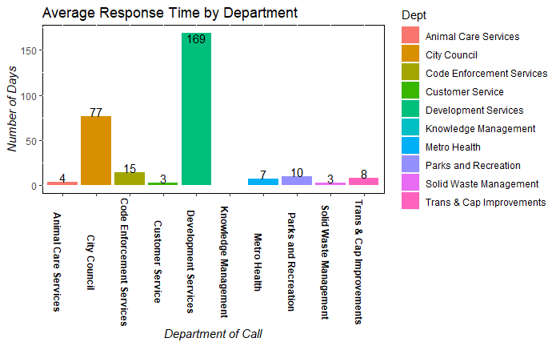
What types of request take the longest to fulfill?

Slide 11
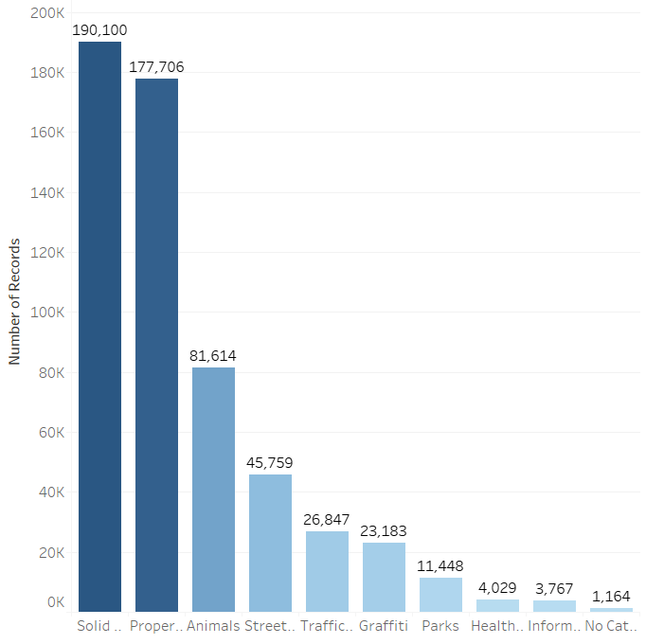
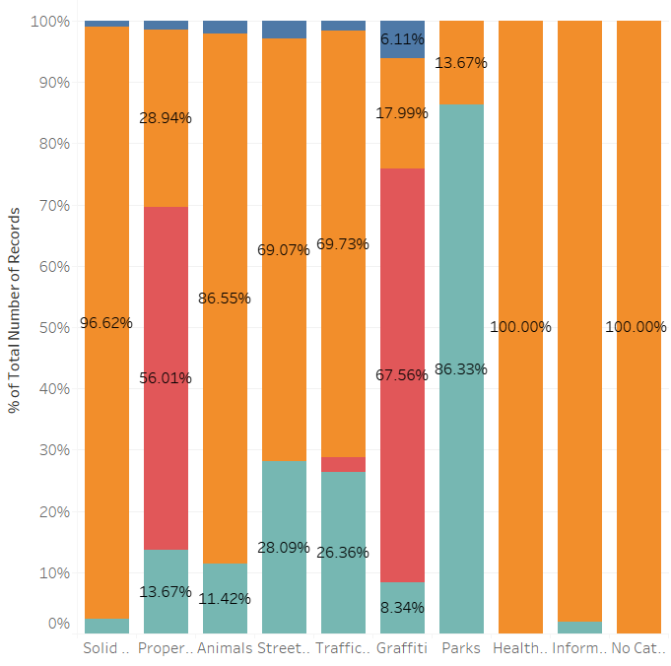
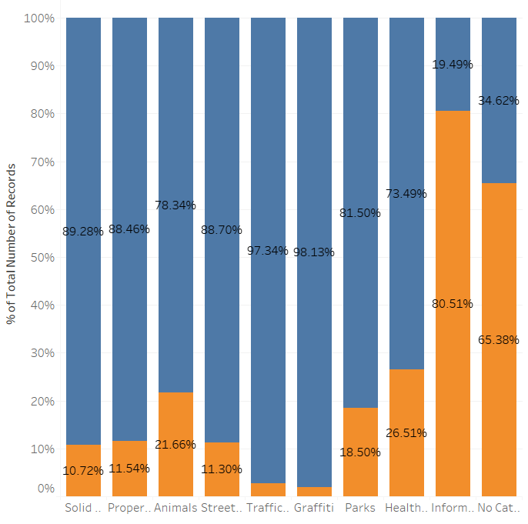
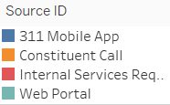
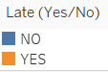
Category Frequency
Source ID by Category
Percent Late by Category

Slide 12
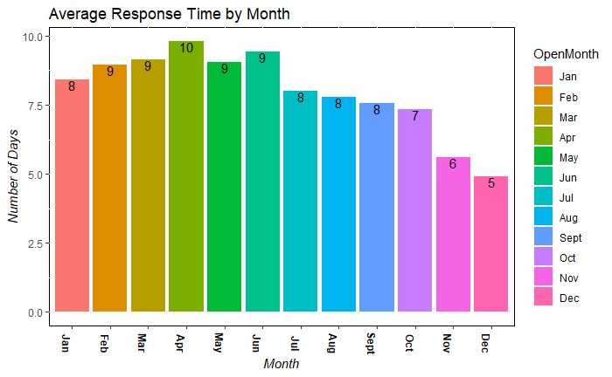
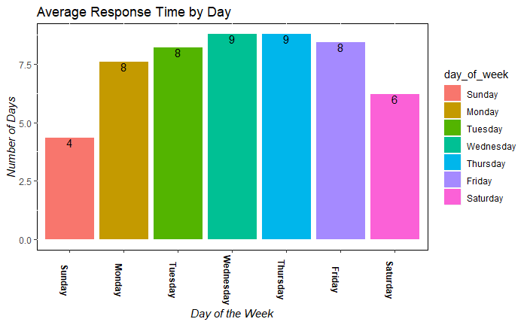
What are the worst times to submit a request?

Slide 13
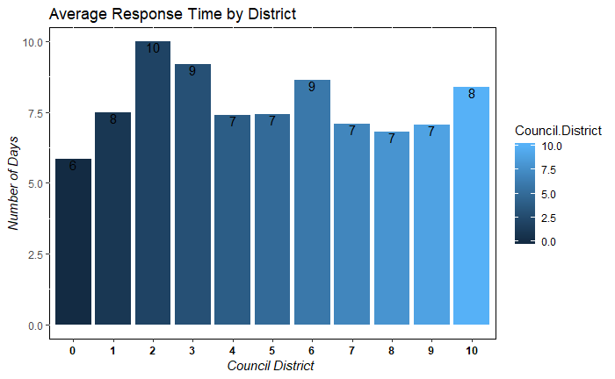
Which district is the slowest to respond?

Slide 14

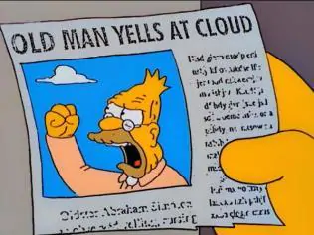
Grumpy-Old-Man subset

Slide 15
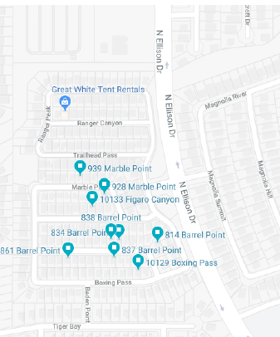
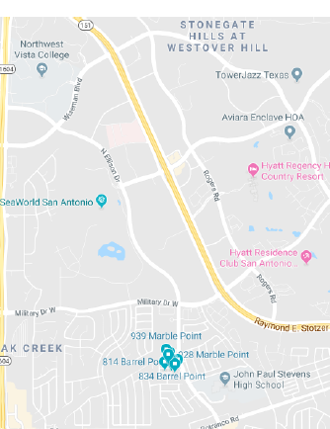
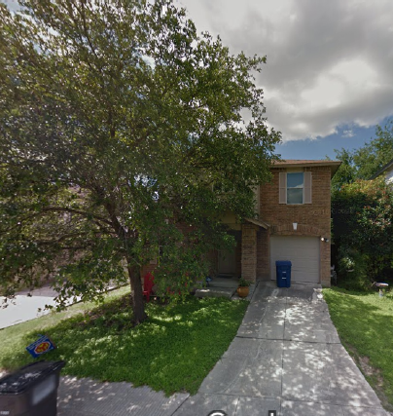
10,507 reports from these 10 addresses in TWO YEARS

Slide 16
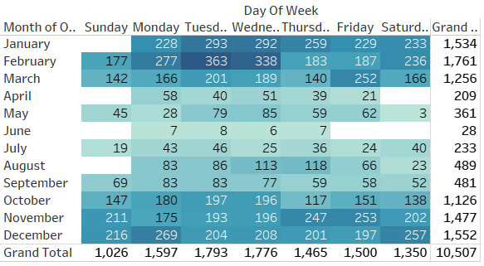
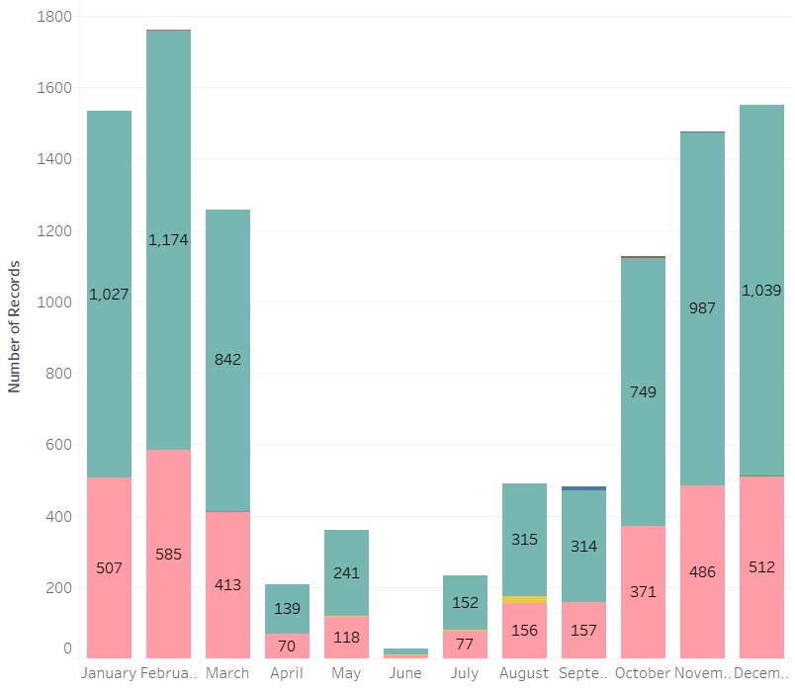
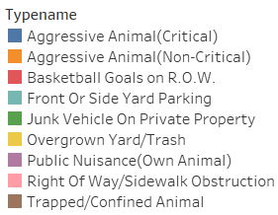
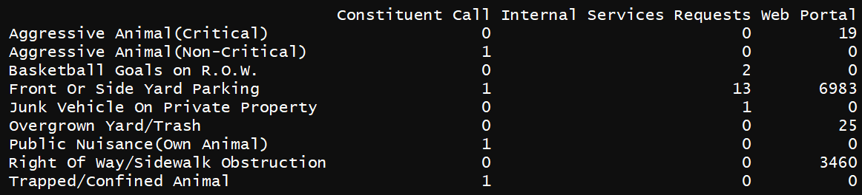
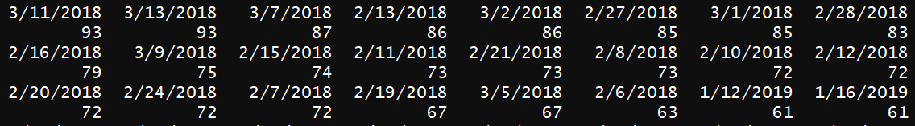
Mostly Parking Issues
Nearly all reports are being made on the web portal regarding parking and sidewalk obstructions.
There is a sharp dip in reports during the summer months.

Slide 17
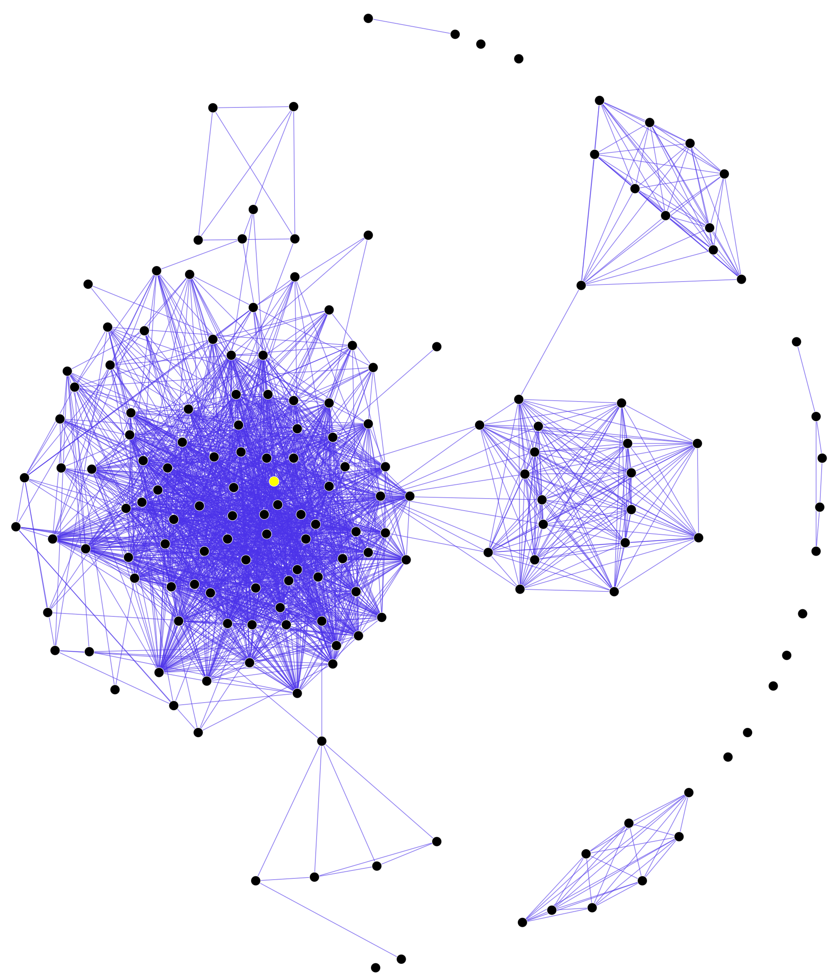
Inferential Analysis

Slide 18
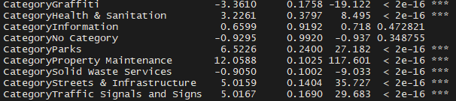
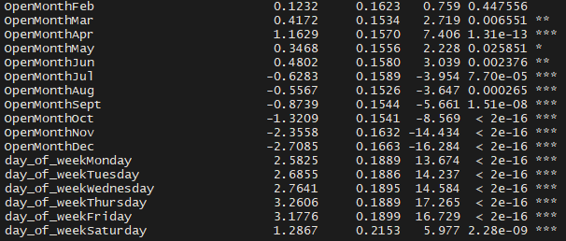
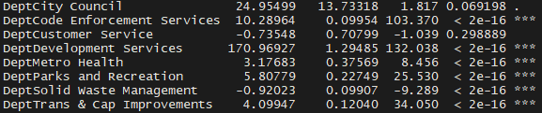
Days to Complete Service Request Regression

Slide 19
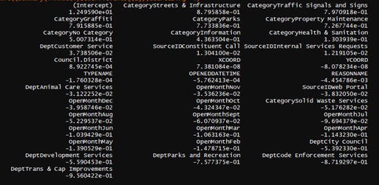
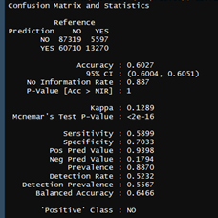
Linear Regression for Lateness

Slide 20
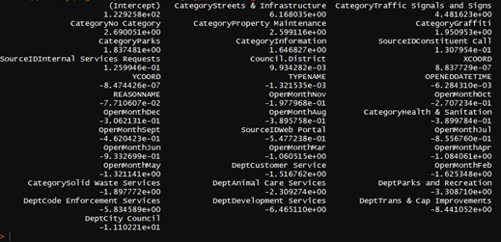
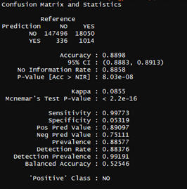
Log Regression for Lateness

Slide 21
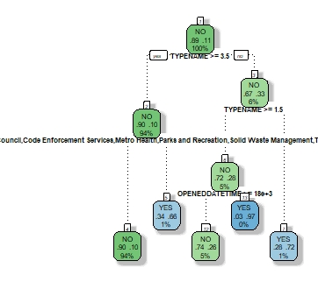
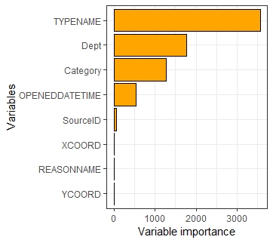
Decision Tree for Lateness

Slide 22
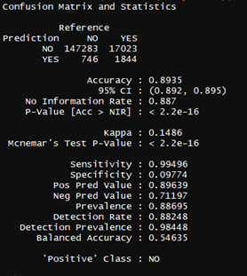
Decision Tree for Lateness

Slide 23
Recommendations
Old App vs. New App. Get your shit together, CityFlag.
What can be done about the grumpy old man?
Better define categories with ‘no information’ as they’re late more often than not.
Find a way to better handle requests for information as they’re the latest of the categories.
Better define “District 0” as it’s five percent later than the rest of the districts.

Slide 24
Questions ?

